Slide 1
CourseTrack
College Course Enrollment System

Slide 2

College Enrollment System
Our project is a Java-based college course enrollment system that follows a client-server architecture.
This tool allows administrators to create and manage the course catalog, maintain class schedules, and update course information as needed. Students can log in to browse available classes, search for specific courses, enroll or drop classes, and view their schedules.
The system also ensures that prerequisites are met, tracks class capacity, manages waitlists automatically, and provides administrators with reporting features to support decision-making.

Slide 3
Top 10 Requirements
Users and Accounts
Administrator Functions
Student Functions
Class Data
Student Data
Enrollment Validation
Waitlisting
Reporting: Basic Statistics and Time-Based Analysis
User Notifications
Data persistence (Course/User Data) on shutdown

Slide 4

Top 5 Classes
Course
  Stores attributes about a specific course:
    Course name
    Course number
    Course capacity
    Course meet times
    Course department
    References to all enrolled and waitlisted students
    References to prerequisite courses
  Automatically handles waitlist when a student drops
Student
  Student class derives from base class User
  Provides functionality for students to enroll in or waitlist courses
  Student class has references to courses the student has:
    Taken
    Enrolled in
    Waitlisted

Slide 5
Top 5 Classes
Campus
  Represents a specific location where courses are held
  Students can belong to one or more campuses
  Has ownership of one or more departments
Department
  Is a division of a campus that stores a campus’s terms
  Has a name
  Has ownership of one or more terms
Term
  Single unit of time that an admin can create and edit
  Attributes include a year and season
    Spring, Summer, Fall
  Has ownership of courses offered

Slide 6
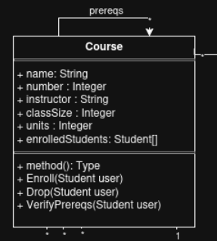
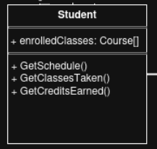
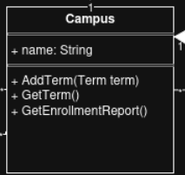
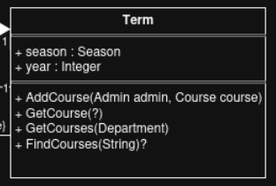
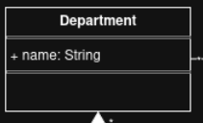
Top 5 Classes UML

Slide 7


